Slide 1

Earbuds Price Analysis through Web Scraping and Exploratory Data Analysis
Presented By:
I. Pradeep

Slide 2
Introduction:
The demand for wireless earbuds has grown exponentially with the rise of smartphones and digital media consumption.
Earbuds have evolved from being luxury accessories to essential audio devices for everyday use.
The market now includes a wide range of brands and models, each competing on price, features, and design.
E-commerce platforms like Flipkart and Amazon have revolutionized the buying experience by offering countless choices at varied price points.
However, this wide variety makes it difficult for customers to compare and identify the best value-for-money options.
Brands often use different pricing and discount strategies to attract buyers, making the true market value unclear.
Consumers rely heavily on ratings, reviews, and brand reputation, which influence purchasing decisions as much as technical specifications.

Slide 3
Business Problem:
Thousands of earbuds are sold online across different price ranges and brands.
Customers struggle to compare true value-for-money options.
Some premium brands charge significantly more despite offering similar performance or features as budget brands.
Brands need insights into how price, discounts, and features affect ratings and popularity.
This project addresses these issues using web-scraped data and exploratory analysis.

Slide 4
Objectives:
Analyze earbud pricing patterns across brands.
Compare price, discount, and customer satisfaction (ratings).
Identify best value-for-money segments.
To compare original price and discounted price to understand how much discount each brand gives.
Visualize brand and feature trends using Python EDA.
To know which price range (low, mid, or high) has the most products and customers.

Slide 5
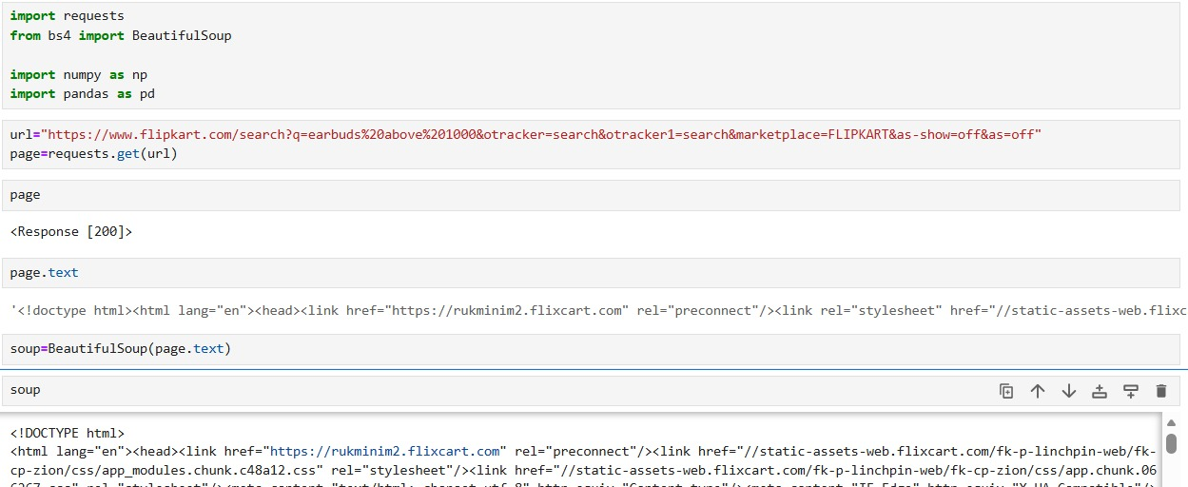
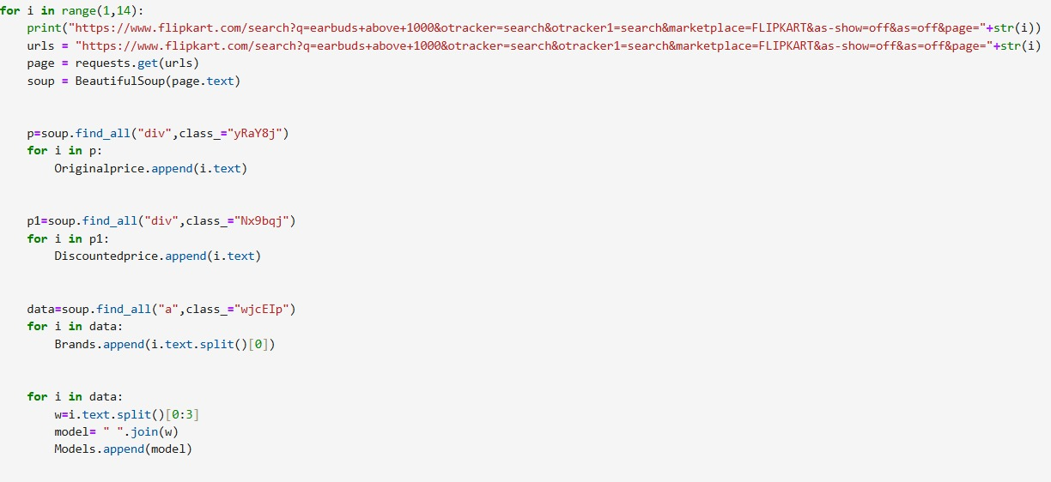

Web Scraping:
Flipkart website was selected as the main data source.
Used browser developer tools (Inspect Element) to identify relevant HTML elements in match data pages.
Used BeautifulSoup and Requests libraries in Python to extract structured data from the web pages
Automated the collection of earbud product details by sending HTTP requests across multiple Flipkart pages.
Cleaned and consolidated scraped data for further analysis and visualization.

Slide 6






Tools Used:

Slide 7
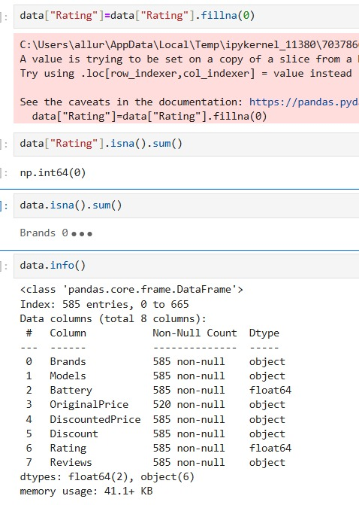
Data Cleaning Steps:
Removed unwanted characters and formatting from OriginalPrice, DiscountedPrice, Discount
Standardized brand and model names.
Converted columns from string/object to integer for OriginalPrice, DiscountedPrice, Discount, Reviews numerical analysis.
Addressed missing or incomplete values in fields like winner or status using “0” or appropriate defaults.
Dropped duplicate rows to make sure each product appears only once in the dataset.

Slide 8
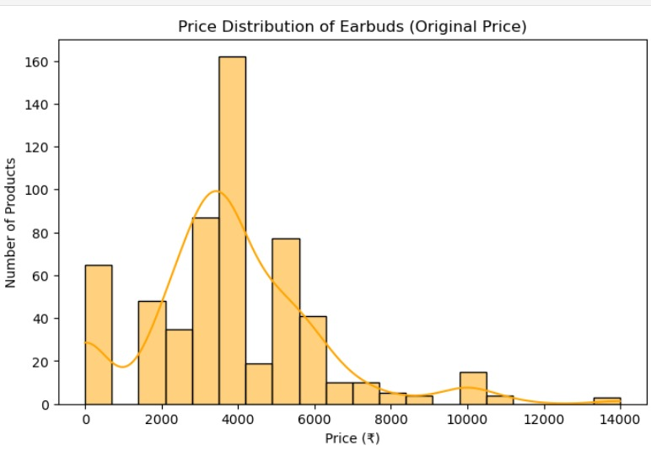
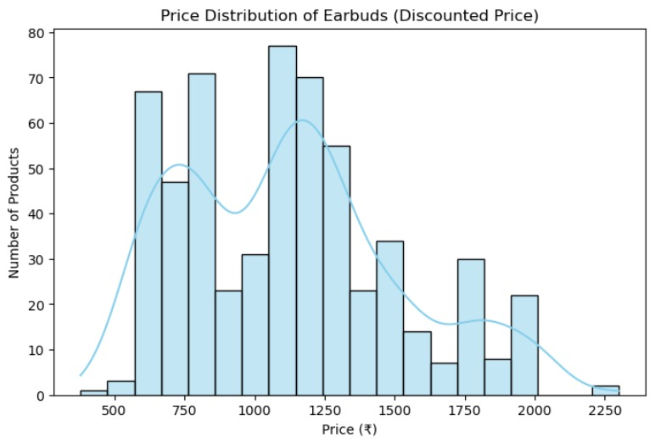
Data Visualization:(Uni-variant)
The original price distribution shows that most earbuds were initially priced between ₹3000 and ₹5000, with a few extending up to ₹14,000.
The distribution is highly right-skewed, suggesting that while most earbuds are marketed at mid-range prices, a small number of premium models significantly raise the upper range.
The majority of earbuds are priced between ₹700 and ₹1300, showing that most products fall within an affordable mid-range segment that appeals to price-sensitive buyers.
The distribution is right-skewed, indicating that while most earbuds are budget-friendly, a few high-priced models exist but are comparatively rare.

Slide 9
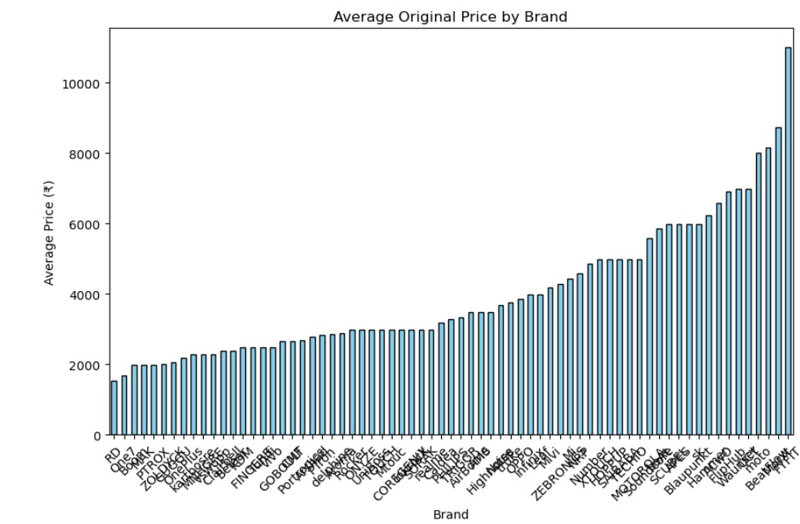
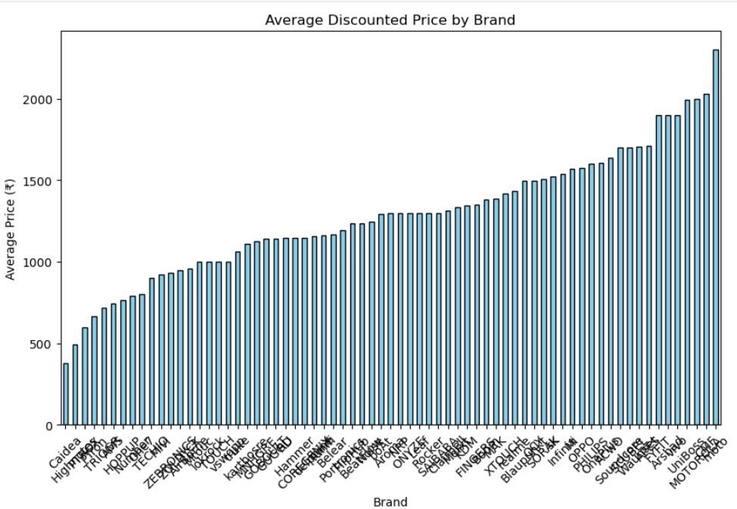
Data Visualization:
The wide gap between original and discounted prices for almost all brands shows that significant discounts are common in the earbuds market, possibly due to competition and frequent sales strategies.​
Lower-priced brands dominate the affordable segment in both original and discounted price charts, while only a handful position themselves as high-end, even after discounts.​
Consumers looking for value are likely to benefit from purchasing during discounts, as even high-MRP brands offer substantial reductions.​

Slide 10
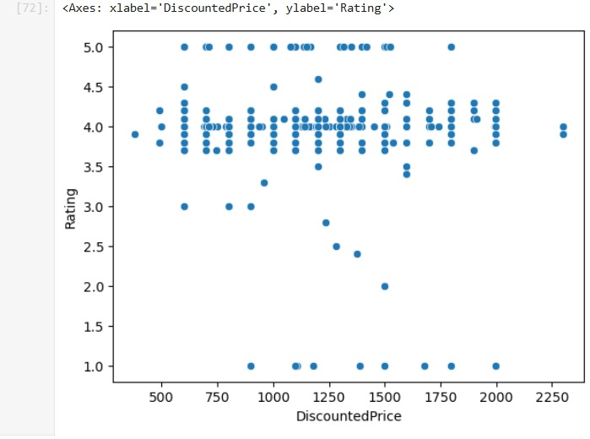
Data Visualization:(Bi-variant)
DiscountedPrice vs Rating
The majority of earbuds products, regardless of their discounted price, cluster around ratings in the 4.0–5.0 range.​
There is no strong correlation between discounted price and rating: both low-priced and high-priced earbuds can receive high ratings.​
A few products at various price points have low ratings (as low as 1.0 or 2.0), but these are much less common than products with high ratings.

Slide 11
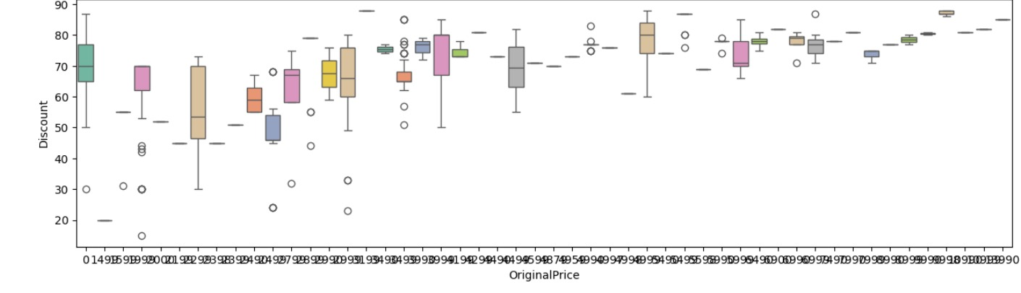
Data Visualization:
OriginalPrice vs Discount:
Higher prices, higher discounts: As the original price increases, the average discount also tends to rise, often exceeding 70–80%.
Wide variation in discounts: There’s considerable spread and several outliers at different price levels, indicating inconsistent discounting practices across products.
More stable discounts at higher prices: At the higher end of original prices, discounts appear more consistent with fewer extreme outliers.

Slide 12
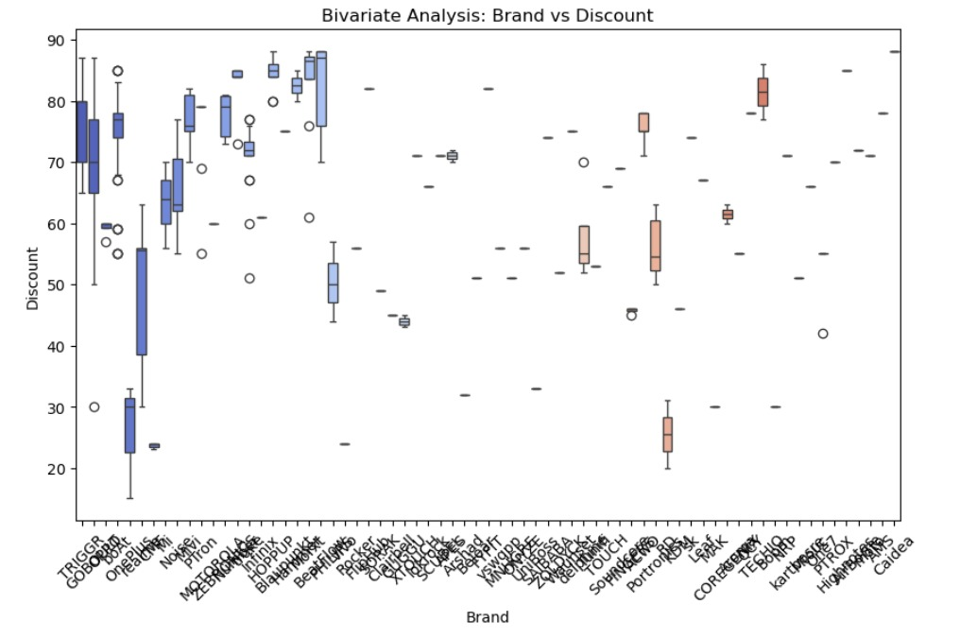
Data Visualization:
Brands vs Discount:
Variation across brands: Discount percentages vary widely between brands — some offer consistently high discounts (around 70–80%), while others give much lower ones.
High-discount brands: Several brands (mostly on the left side) tend to provide larger and more frequent discounts.
Consistency differences: Some brands have tight discount ranges (consistent pricing strategy), while others show wide spreads and outliers, indicating inconsistent discounting across their products.

Slide 13
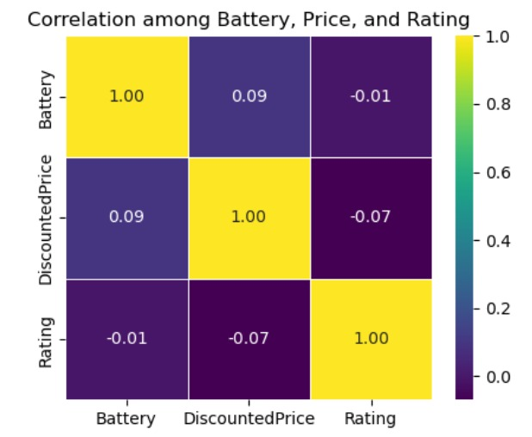
Data Visualization:(Multi-variant)
Heatmap for Battery,Price,Rating:
The main takeaway is that battery capacity and price are largely independent of product ratings in the current earbuds market.
This underlines that buyers should focus on both price and product features (other than battery life) when making purchasing decisions and not rely solely on high price as an indicator of quality or satisfaction.​
Brands should note that boosting battery life or pricing alone is unlikely to directly improve user ratings

Slide 14
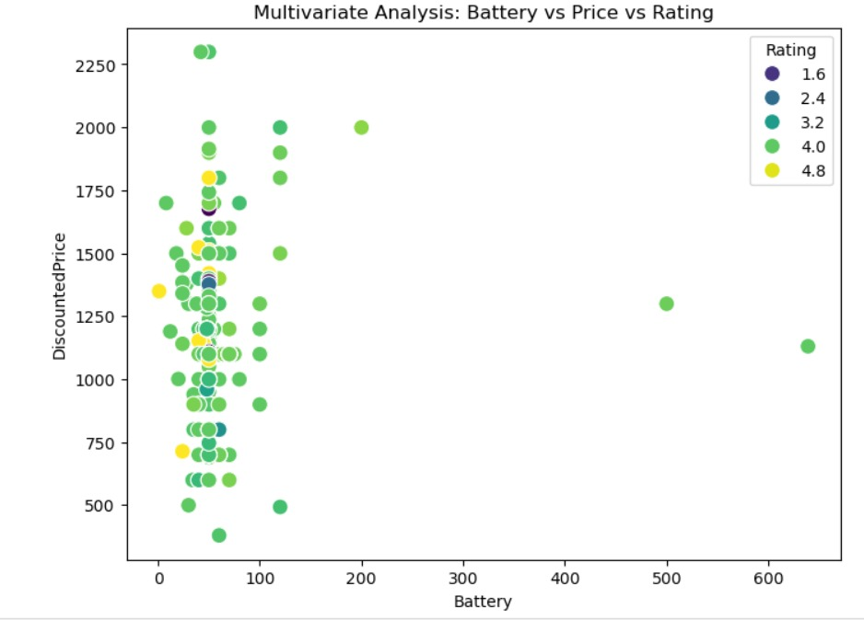
Data Visualization:
Battery vs Price vs Rating:
Most earbuds have battery capacities concentrated below 100 hours, across a wide range of discounted prices.
The majority of products, regardless of battery life, cluster between ₹500 and ₹1750 discounted price, which suggests most brands target the mid-range affordability segment.
Higher battery does not always mean a higher price, and low-rated products are scattered across the chart, not grouped together.
High product ratings are found at almost all price and battery combinations, so even affordable earbuds with normal battery life can get good reviews.

Slide 15
Key Business Questions
Which price range dominates the market?
Which brands offer best discounts?
Does higher battery mean higher price?
Are ratings linked with pricing?
Which brand offers best value overall?

Slide 16
Conclusion:
Most earbuds are priced between ₹1000–₹2000, showing strong customer demand for mid-range, affordable options.
The analysis helped in understanding how different factors like brand, battery life, discounts, and ratings influence earbud pricing.
BoAt and Noise dominate this segment by offering good quality products at competitive prices.
Discounts and ratings play a major role in customer purchasing decisions, more than brand name alone.
Data analytics helped reveal hidden trends, showing that great performance and customer satisfaction are possible even in budget-friendly products.

Slide 17
Experience– Web Scraping & Data Analysis:
We gained hands-on experience in web scraping, learning how to collect real product data directly from e-commerce websites like Flipkart.
We understood the importance of data cleaning, especially how small errors like missing values or inconsistent brand names can affect analysis results.
We learned to use Python libraries such as Pandas, Matplotlib, and Seaborn for data analysis and visualization.
Learned end-to-end data workflow: scraping → cleaning → analysis → visualization.

Slide 18
Challenges – Web Scraping & Data Analysis:
While scraping Flipkart, the HTML structure sometimes changed, making it difficult to extract data consistently.
Some products didn’t have ratings, reviews, or battery details, so we had to clean and fill those values carefully.
Prices and discounts contained symbols like ₹, %, and commas that had to be removed before converting to numbers.
Cleaning, analyzing, and visualizing data took more time than expected due to dataset inconsistencies.

Slide 19
Thank You

